Slide 1

Using Rigid Transformation in Simscape to make new frames
Anjan Kumar Dash
SASTRA Deemed Univeristy

Slide 2
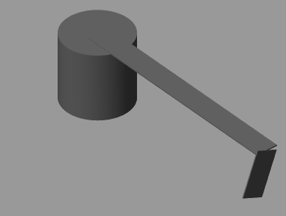
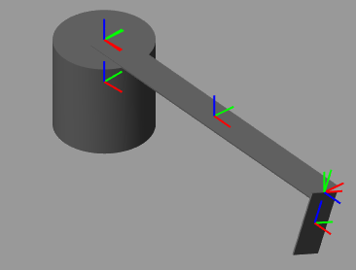
r

Slide 3
To do
Total 3 brick solids- cylinder, link horizontal, link vertical and two joints (spatial)
Frames
Cylinder comes with a default reference frame at its CG. We have to make one more frame at the top such that horizontal link can be attached. (rigid transformation 1)
Horizontal link comes with a default reference frame. We have to make one frame at the origin of the link (rigid transformation 2).
We also have to make one more frame at the end of the horizontal link where vertical link will be connected (rigid transformation 3)
Vertical link also comes with a reference frame at its CG. We have to make one more frame at its origin which will be connected to the horizontal link (rigid transformation 4)

Slide 4
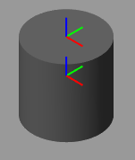
Cylinder Rigid Transformation
This has to be made by rigid transformation of the reference frame of cylinder
Reference frame (comes by default)

Slide 5
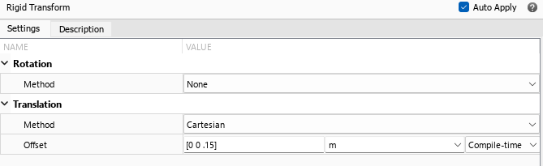
Rigid transformation 1

Slide 6
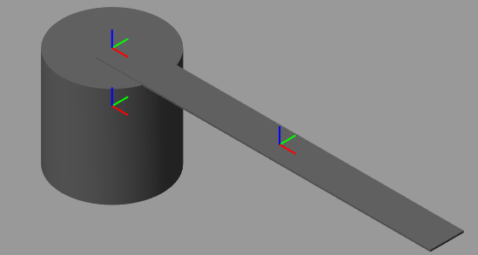
Once this is done you bring in a revolute joint and connect it to the top frame of the cylinder.
Then you bring in the horizontal link.
This has to be made by rigid transformation of the reference frame of the link
Reference frame (comes by default)

Slide 7
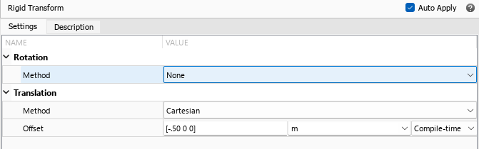
Rigid transformation 2

Slide 8
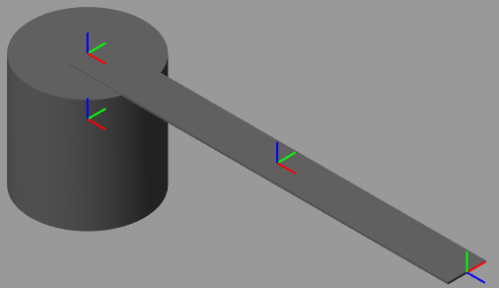
Z
Y
X
Z
Red- X axis
Green-Y axis
Blue- Z axis
Note the end frame.
Z-axis is changed by
Rigid transformation.
Y
X
Y
X
This has to be made by rigid transformation of the reference frame of the link
Z

Slide 9
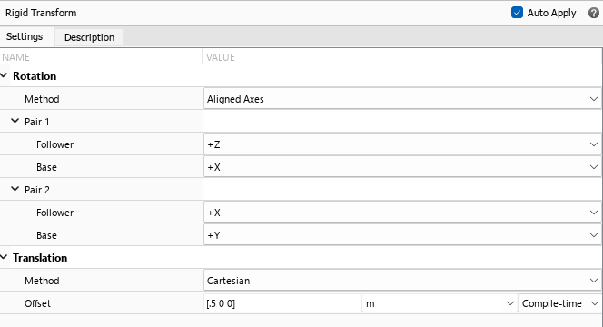
Rigid transformation 3

Slide 10
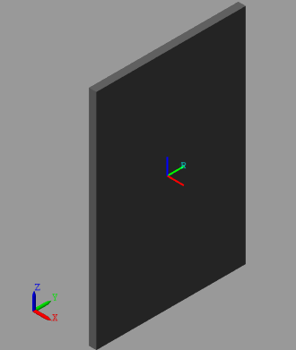

Then you bring in the 2nd revolute joint. Pl remember when you bring in the revolute joint, its Z axis accepts the Z axis of the frame to which it is attached.
By this now the Z axis is changed.
Then you bring in the vertical link. (x=.005; y=.1; z=.15)
Frame created by rigid transformation 4. Mark the Z-axis in blue
Y
Reference frame (comes by default; see X-Red, Y-Green and Z-Blue)
X
Z
Z
Y
X

Slide 11
